Slide 1

The NeeDoh Navigator
Real-time inventory tracking and automated restock alerts for high-demand sensory toys.
Kaylee Leiva
Solo Project | Application Development I
Project Sprint 3 PPT Splash Screen

Slide 2

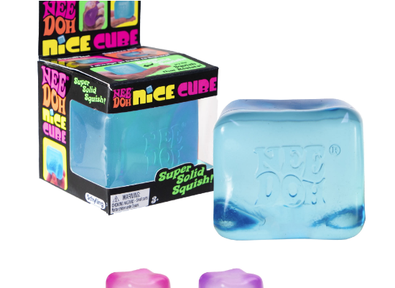
The Scarcity Challenge
Viral popularity on TikTok has turned "NeeDoh" stress balls into high-demand collectibles that sell out in minutes.
•
Manual refreshing is inefficient and results in missed restock windows.
•
Collectors and parents are forced to pay 300% markups to resellers.

Slide 3






Three Pillars of Automation
Monitor
Analyze
Notify
Periodically scrapes retail pages like Amazon and Target to check inventory availability status.
Uses Python logic to parse HTML elements and identify the presence of "Add to Cart" buttons.
Sends instantaneous desktop alerts the moment a restock is detected by the scraper loop.

Slide 4
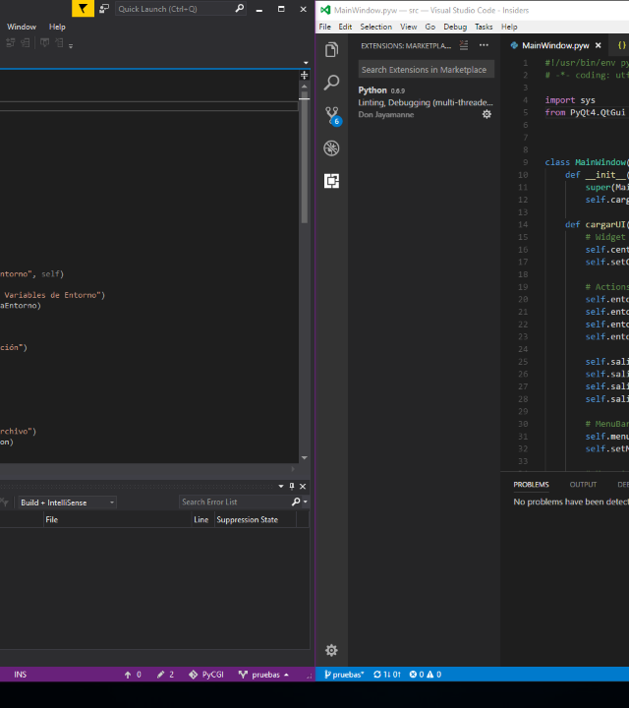
Built with Python
Leveraging BeautifulSoup and the Requests framework to build a robust, lightweight tracking engine.
The system operates in a headless background loop, minimizing resource usage while maximizing tracking frequency.

Slide 5
Key Performance Metrics
100%
Automated Tracking
Removes the need for human intervention. The software pings retail servers 24/7, ensuring that Kaylee can secure rare items at retail prices without manually refreshing a single browser tab.

